Slide 1



Anna Collyer | Chair, AEMC
Creating competitive
energy markets by
incentive regulation
Australian Energy Market Commission | 23 September 2026

Slide 2
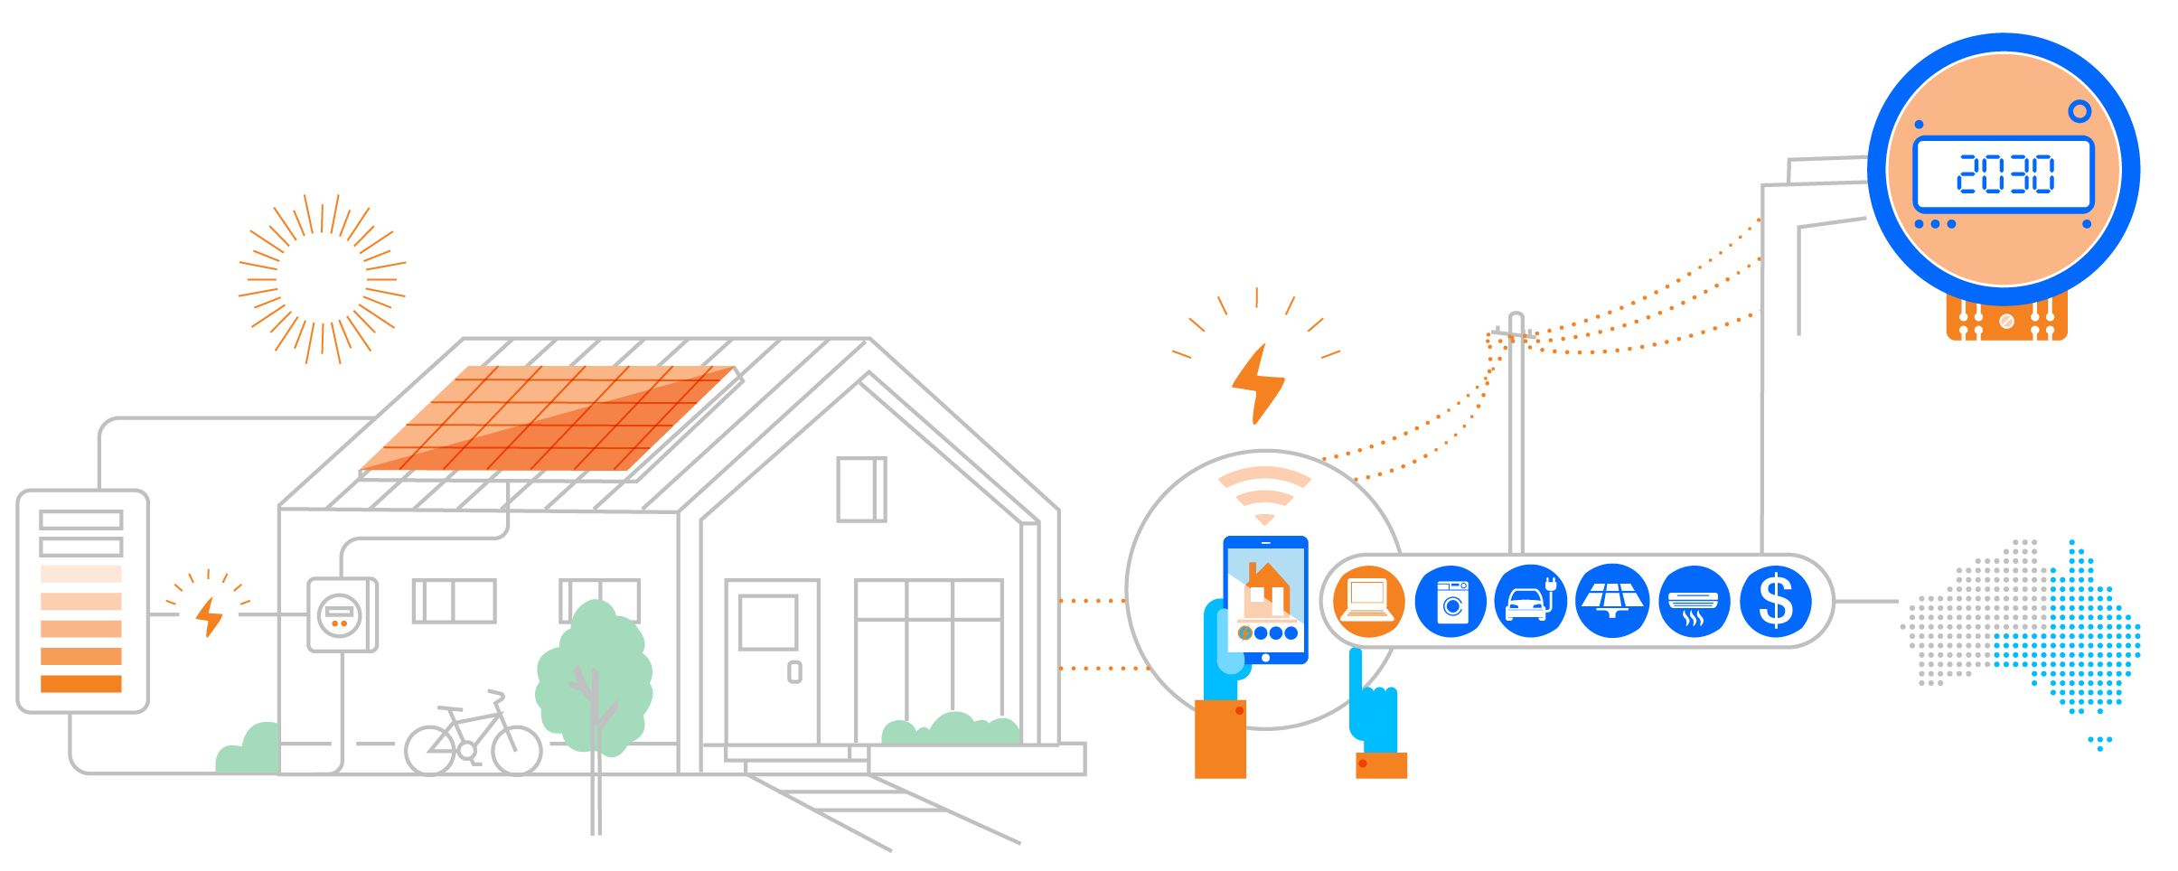
Building the digital foundation
Smart meters enable consumer energy resources to participate at scale
Universal smart meter rollout by 2030 across Australia’s National Electricity Market
Real-time data access from 2028
Consumer-authorised sharing

Slide 3
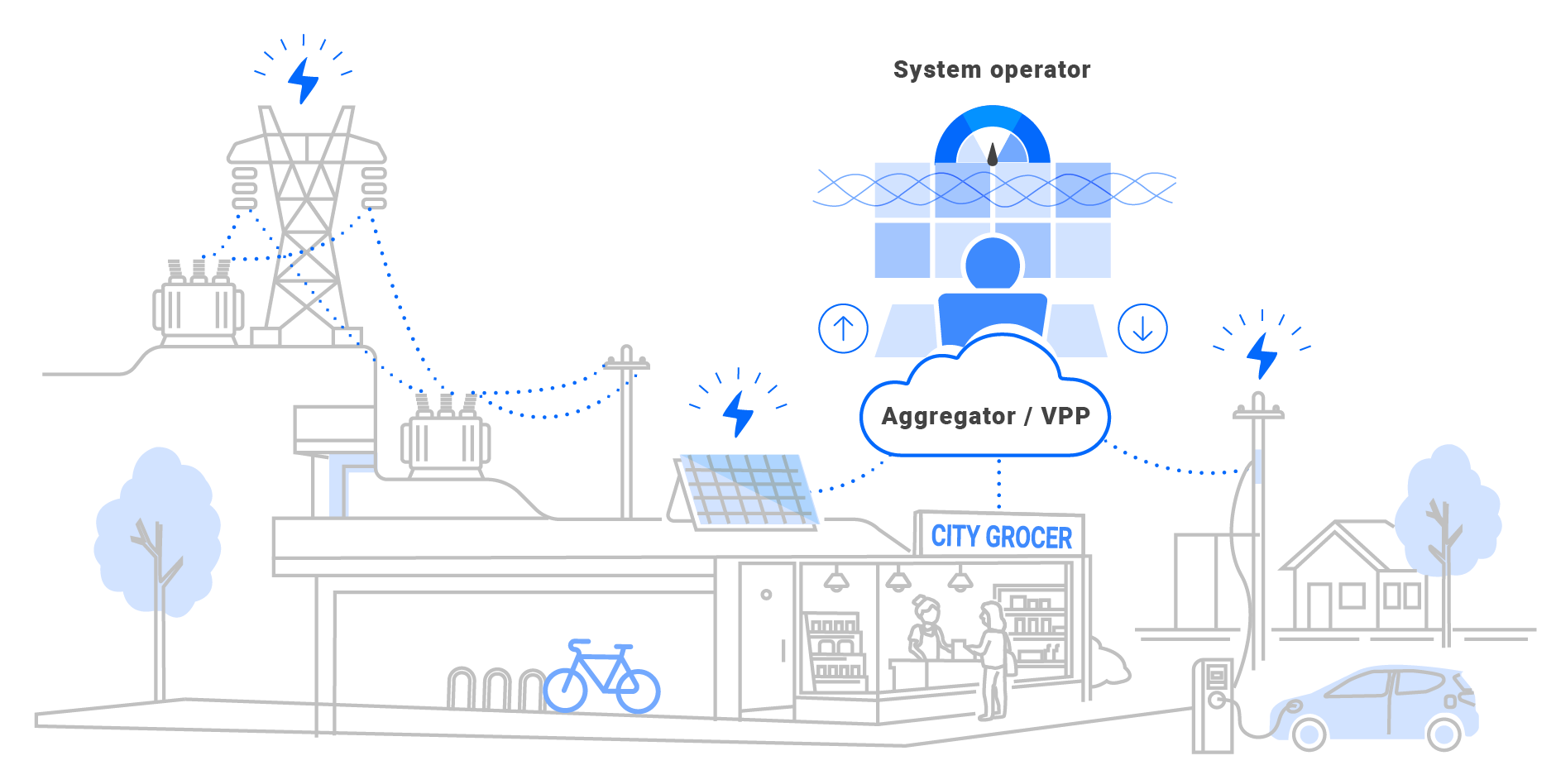
Making distributed resources visible to the market
Voluntary participation through aggregation

Slide 4

Reward value, manage complexity
Better network signals, simpler offers for consumers
Network tariff
reflects system conditions
↓
Retailer / service provider
manages risk +
coordinates flexibility
↓
Consumer
simple offer + choice
AEMC Pricing Review
Spare capacity
Battery action = lower network value
Network under pressure
Battery action = higher network value
Costs Reward

Slide 5

Creating competitive energy markets by incentive regulation
Anna Collyer
AEMC, Chair

